Slide 1
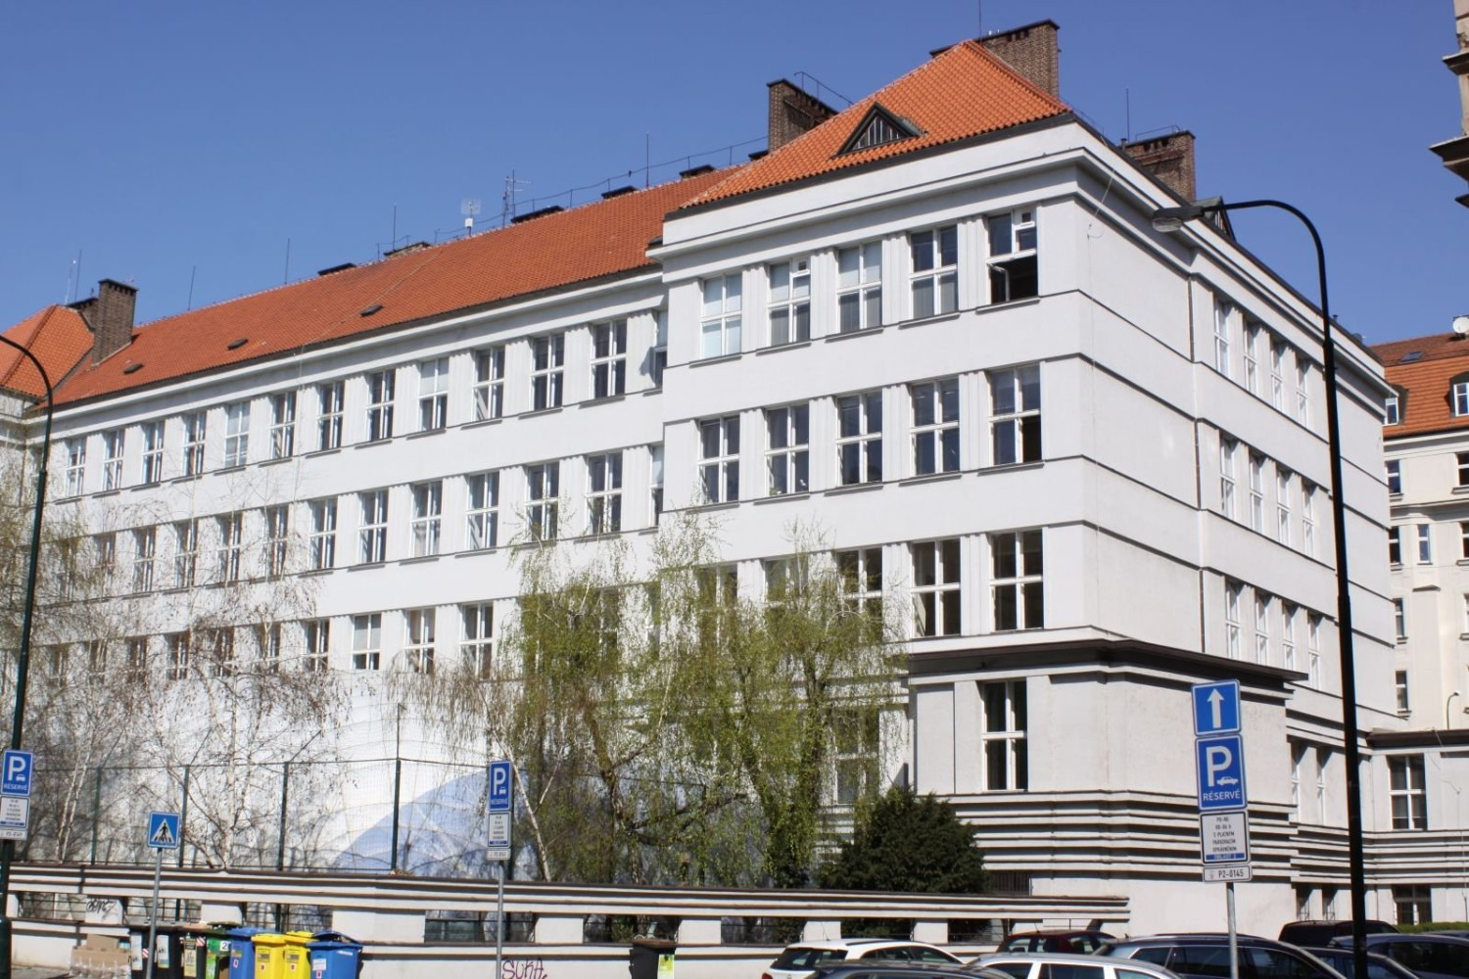
Our school
(and the Czech school system)

Slide 2

Czech school system
Primary school
- 9 years (compulsory school attendance)
- entrance exams (přijímací zkoušky)
High school
- practical vocational school/grammar school/secondary vocational school
- 4 years/3 years
- school-leaving exams (Maturita)/final exams (Závěrečné zkoušky)
College / University
- 3-5 years
- Bachelor’s and Master’s degrees

Slide 3
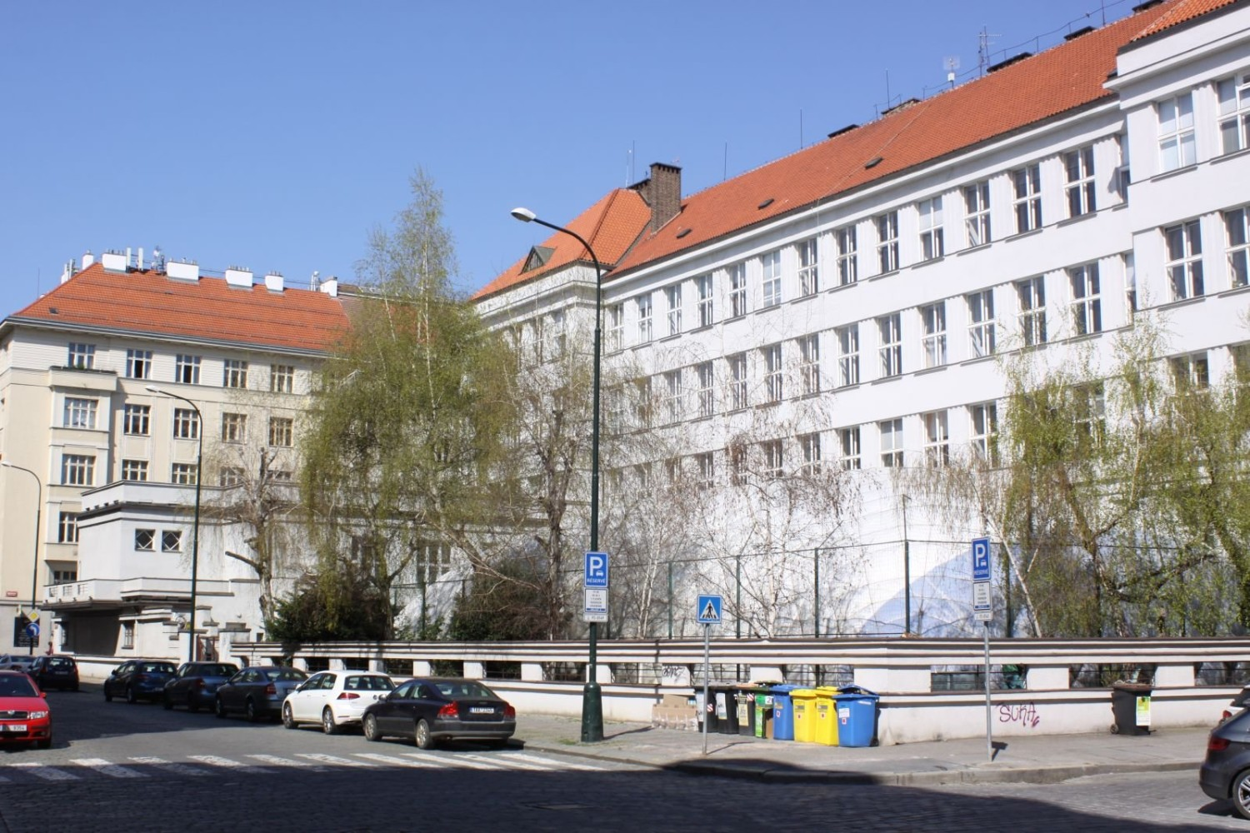
SPŠ, SOŠ and G Podskalská
Secondary technical school of food technologies,
Secondary vocational school of natural sciences and veterinary medicine
and Grammar school

Slide 4
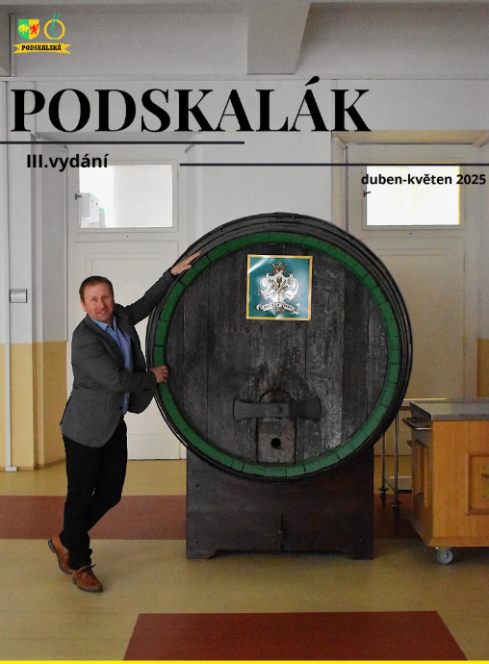
Basic information
2 buildings
850 students
85 teachers
headmaster Václav Krámek
4 schedules - each for one week
school magazine Podskalák

Slide 5
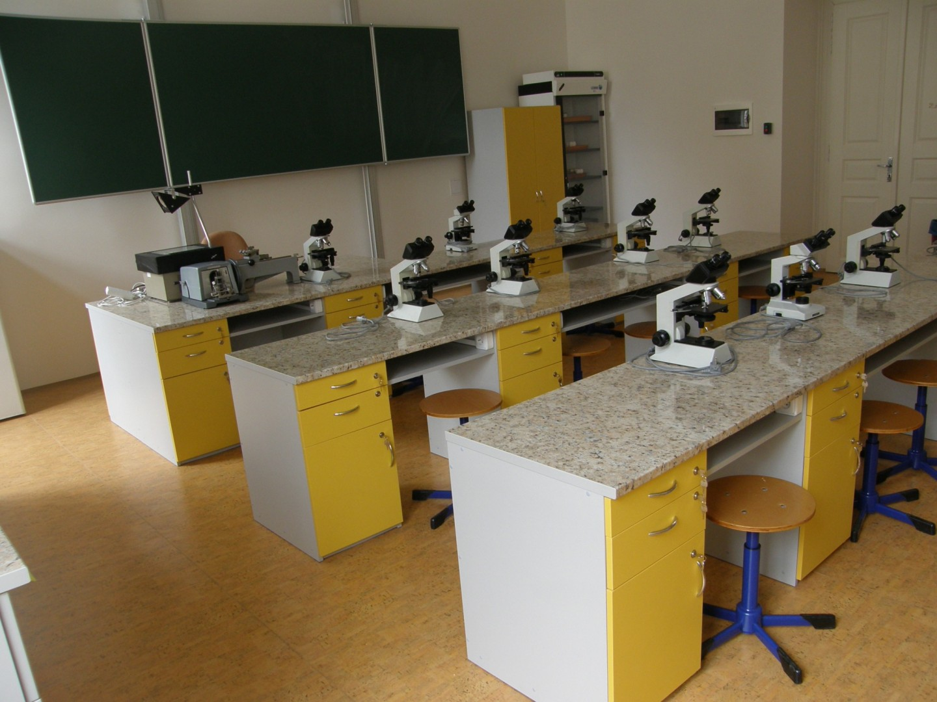
Our study specializations
4-year study programmes ending with the school-leaving exams (maturita)
Grammar school
Food analysis
Ecology and enviromental protection
Natural sciences lyceum
Veterinary science
Technology of beer, wine, spirits and non-alcoholic beverages
Flour processing, bakery and confectionery technology
Meat processing and meat products technology

Slide 6
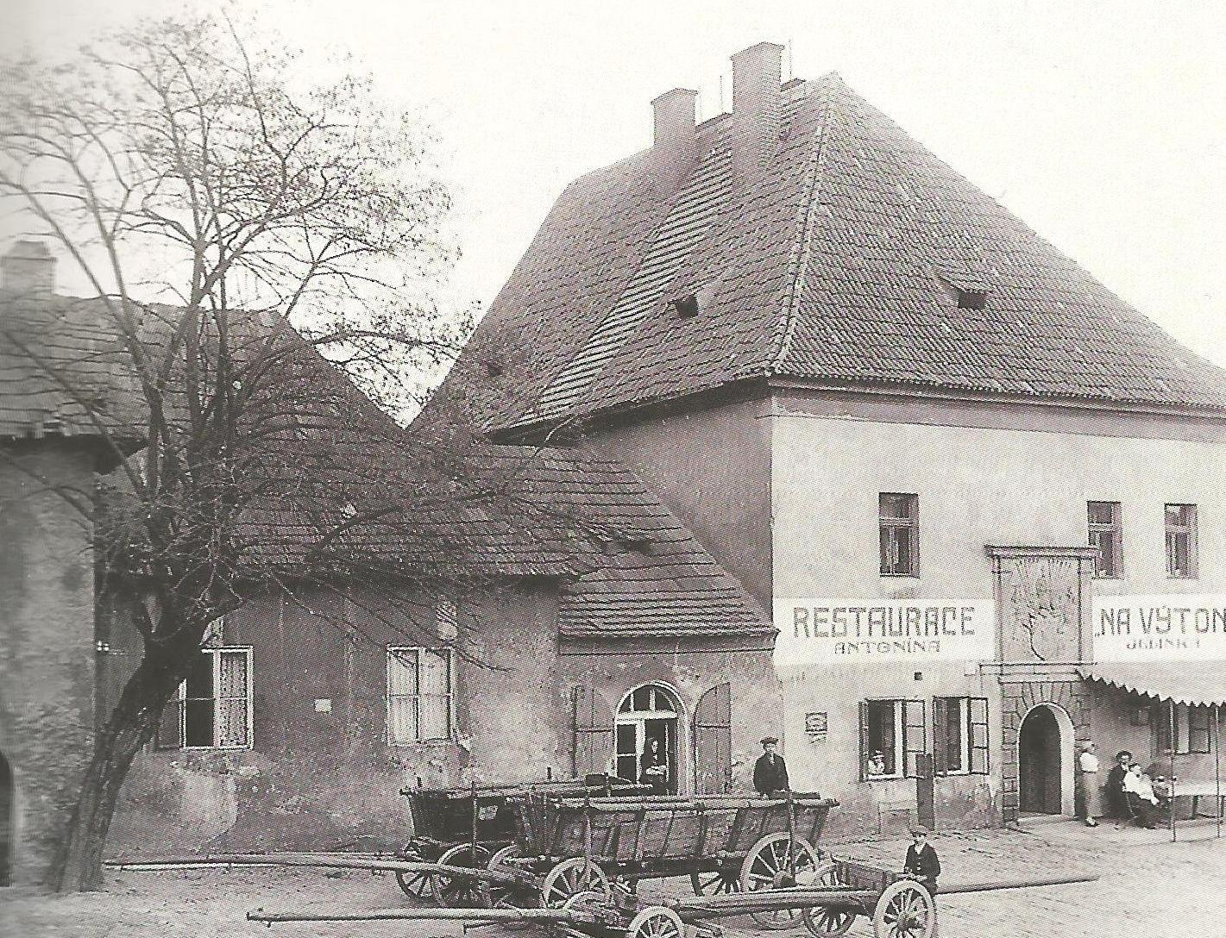
History
originally established as a malting and brewing school in 1828
the school was moved to the current building in 1950
this building dates from 1928
it was merged with the Secondary Technical School of Meat Technology in Navrátilova street in 2007
we opened the first class of the Grammar school in 2021
originally established as a malting and brewing school in 1828
the school was moved to this current building in 1950
this building dates from 1928
it was merged with the Secondary Technical School of Meat Technology in Navrátilova street in 2007
we opened the first class of the grammar school in 2021

Slide 7
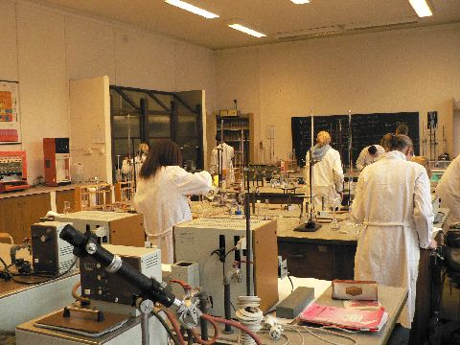
School facilities
9 specialized laboratories (microbiology, analytical chemistry…)
7 language classrooms
6 computer science classrooms
2 libraries
1 gym, fitness room, mirrored hall, multipurpose hall
1 school cafeteria
1 meat processing workshop
1 brewery
1 bakery
1 veterinary clinic

Slide 8
THANK YOU FOR YOUR ATTENtION

